Slide 1
A Simple Framework for Contrastive Learning of Visual Representations
Chen, Ting, et al.
International conference on machine learning. PMLR, 2020.
220719 랩미팅
김소희

Slide 2
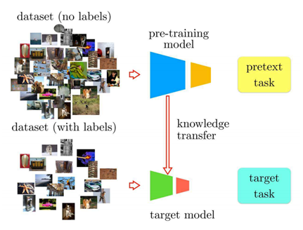
1. Introduction
Chen, Ting, et al. "A simple framework for contrastive learning of visual representations." International conference on machine learning. PMLR, 2020.
Self-Supervised Learning
데이터에서 얻을 수 있는 정보를 사용해서 자체적인 label을 얻기 위해 고안된 방법
Learning effective visual representations without human supervision – 오랜 연구 분야
Representation 학습 : 인간의 간섭 없이 모델이 스스로 task에 적합한 feature들을 알아내는 것
Most mainstream approaches
Generative approaches
Pixel level generation : expensive, not be necessary
Discriminative approaches
Pretext task 사용해서 학습 : generality 한계가 있음
> Pretext task 사용 학습
https://velog.io/@jhlee508/논문-정리-A-Simple-Framework-for-Contrastive-Learning-of-Visual-Representations
Notes:
Self-supervised learning : 데이터에서 얻을 수 있는 정보를 사용해서 자체적인 label을 얻기 위해 고안된 방법

Slide 3
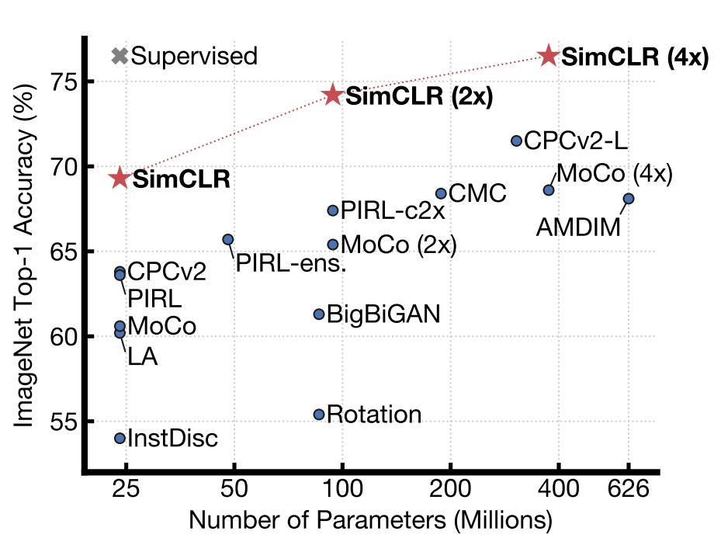
1. Introduction
Chen, Ting, et al. "A simple framework for contrastive learning of visual representations." International conference on machine learning. PMLR, 2020.
SimCLR - a simple framework for contrastive learning of visual representations
Major components
간단한 몇 개의 Data augmentation composition(조합)이 SimCLR 구조에서 중요한 역할을 한다.
Representation과 Contrastive loss 사이의 non-linear transformation이 representation 성능을 향상시킨다.
Contrastive learning은 batch size와 training step이 클 때 효과적이다.
ImageNet Top-1 accuracy of linear classifiers trained on representations learned with different self-supervised methods (pretrained on ImageNet). Gray cross indicates supervised ResNet-50. Our method, SimCLR, is shown in bold.

Slide 4
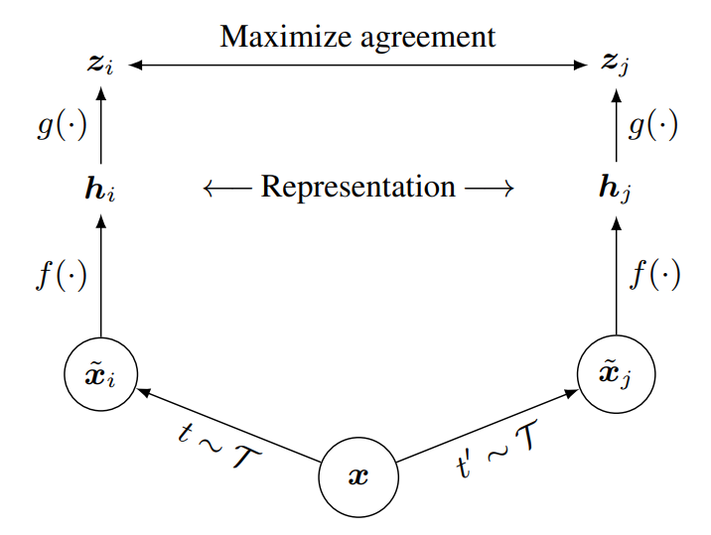
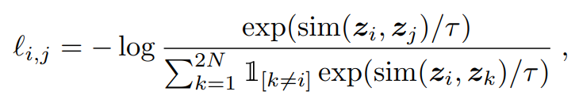
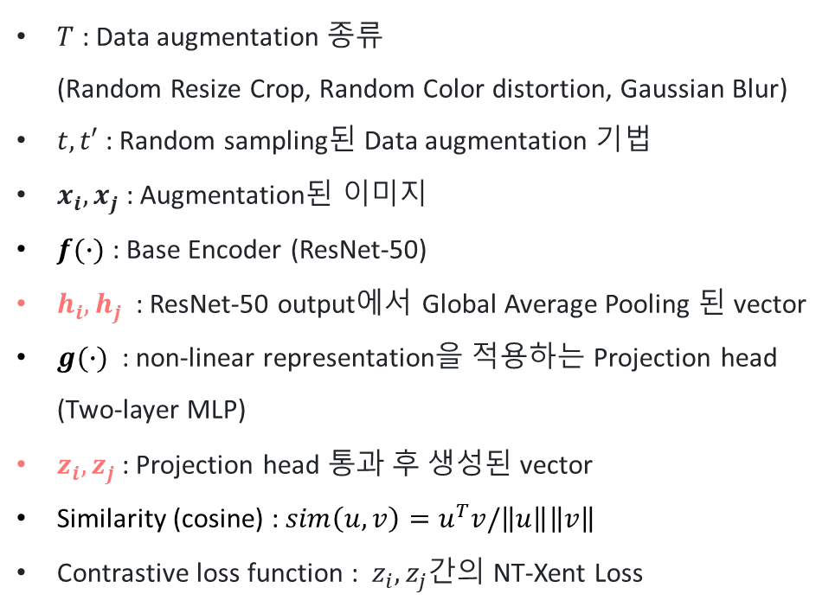
2. Method
Chen, Ting, et al. "A simple framework for contrastive learning of visual representations." International conference on machine learning. PMLR, 2020.
The Contrastive Learning Framework
$T$ : Data augmentation 종류 (Random Resize Crop, Random Color distortion, Gaussian Blur)
$t, t′$ : Random sampling된 Data augmentation 기법
$x_{i}, x_{j}$​ : Augmentation된 이미지
$f(∙)$ : Base Encoder (ResNet-50)
$h_{i}, h_{j}$​ : ResNet-50 output에서 Global Average Pooling 된 vector
$g(∙)$ : non-linear representation을 적용하는 Projection head (Two-layer MLP)
$z_{i}, z_{j}$: Projection head 통과 후 생성된 vector
Similarity (cosine) : $sim\left(u,v\right)=u^{T}v/\left\|u\right\|\left\|v\right\|$
Contrastive loss function : $z_{i}, z_{j}$간의 NT-Xent Loss
MLP
Encoding
(ResNet50)
Data augmentation
같은 이미지 → similarity가 높음
다른 이미지 → similarity가 낮음

Slide 5
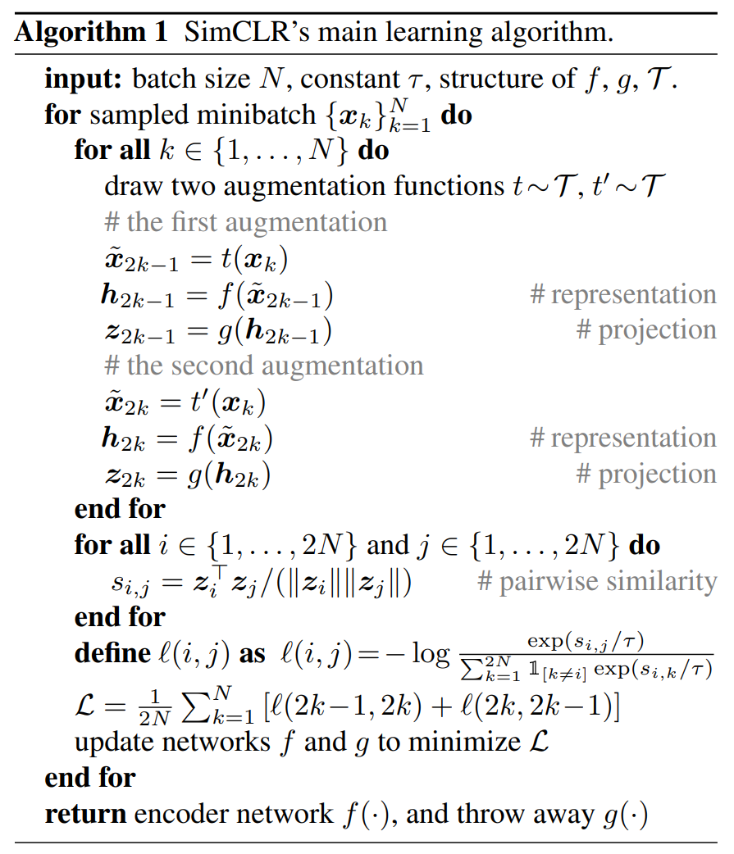
2. Method
Chen, Ting, et al. "A simple framework for contrastive learning of visual representations." International conference on machine learning. PMLR, 2020.
The Contrastive Learning Framework
MLP
Encoding
(ResNet50)
Data augmentation
No explicit negative sampling
Minibatch 안에서 사용 - 2(N-1)개

Slide 6
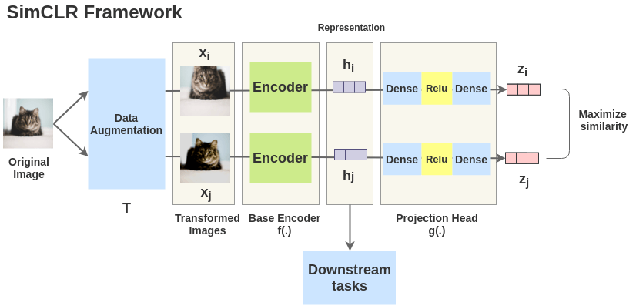
2. Method
Chen, Ting, et al. "A simple framework for contrastive learning of visual representations." International conference on machine learning. PMLR, 2020.
The Contrastive Learning Framework
https://amitness.com/2020/03/illustrated-simclr/

Slide 7
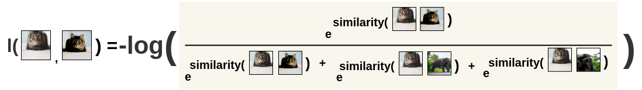
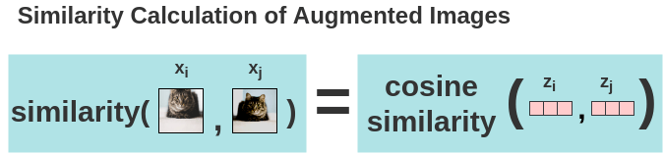
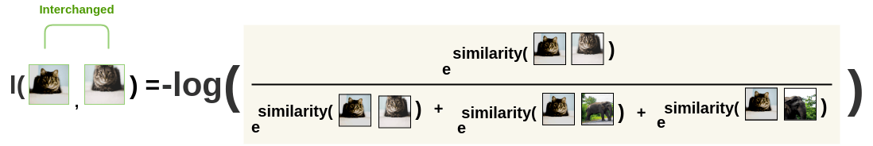
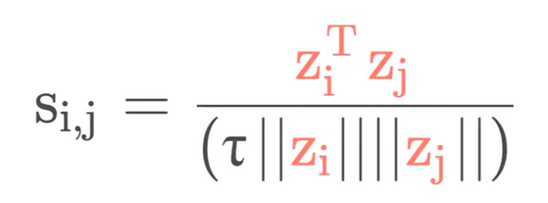
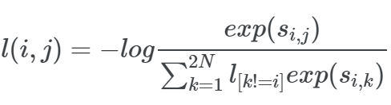
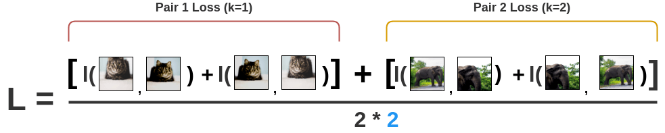
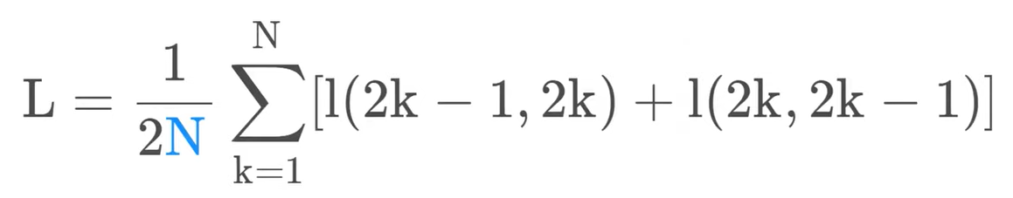
2. Method
Chen, Ting, et al. "A simple framework for contrastive learning of visual representations." International conference on machine learning. PMLR, 2020.
The Contrastive Learning Framework
Cosine similarity
NCE Loss : -log(softmax)
모든 pair의 loss 평균
https://amitness.com/2020/03/illustrated-simclr/

Slide 8
2. Method
Chen, Ting, et al. "A simple framework for contrastive learning of visual representations." International conference on machine learning. PMLR, 2020.
Overview
Training
Batch size: 256 ~ 8192
LARS optimizer 사용 : 많은 Batch size 학습을 감당하기 위해
Aggregating BN mean and variance over all devices
Dataset
ImageNet 2012 – unsupervised pretraining
Evaluation
Linear Evaluation Protocol : representation까지의 parameter를 freeze하고, linear layer 하나만 추가하여 supervised learning, evaluation 진행

Slide 9
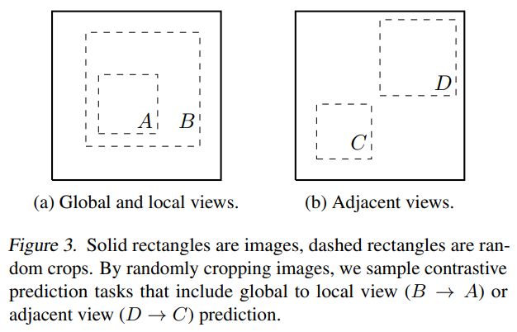
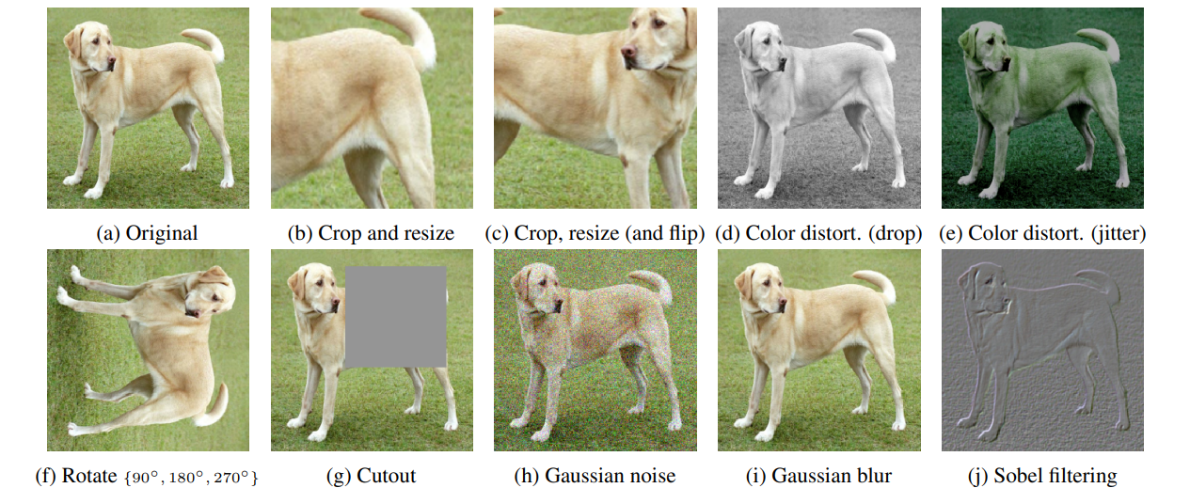
3. Data Augmentation for Contrastive Representation Learning
Chen, Ting, et al. "A simple framework for contrastive learning of visual representations." International conference on machine learning. PMLR, 2020.
Data Augmentation
Augmentation 방법
기존 : architecture를 수정하며 contrastive prediction tasks 수행
Simple random cropping of target images – 위에 두가지 다 포함
Spatial/geometric transformation
Cropping, resizing, rotating, cutout
Appearance transformation
Color distortion, Gaussian blur, Sobel filtering
Predictive task를 NN architecture와 decouple(분리)

Slide 10
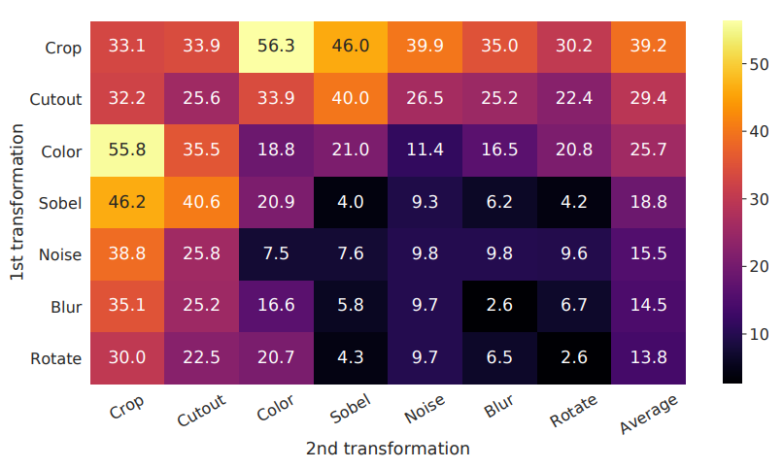
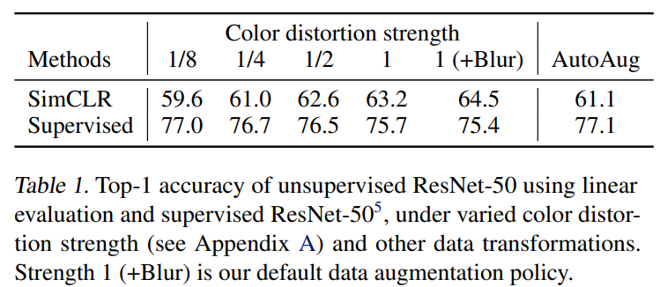
3. Data Augmentation for Contrastive Representation Learning
Chen, Ting, et al. "A simple framework for contrastive learning of visual representations." International conference on machine learning. PMLR, 2020.
Augmentation 방법 별 실험 결과
Color Augmentation strength
Stronger color augmentation → 성능↑
Simple cropping + stronger color distortion > Auto Augment
Supervised models – 강할수록 성능 좋아지지 않음
Augmentation 방법 1개만 하는 경우보다 여러 개 하는 경우가 prediction task의 난이도를 높여 더 좋은 representation을 얻을 수 있음
7가지 중 Random Crop + Random Color Distortion이 가장 성능이 좋음
Notes:
Branch 한쪽은 crop만, 다른 한쪽은 augmentation 방법 사용해서 각 방법의 성능 실험함

Slide 11
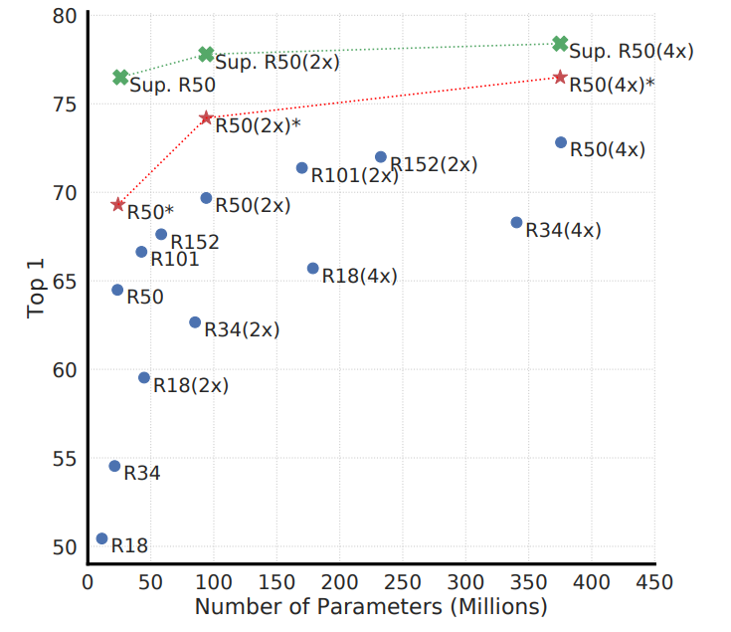
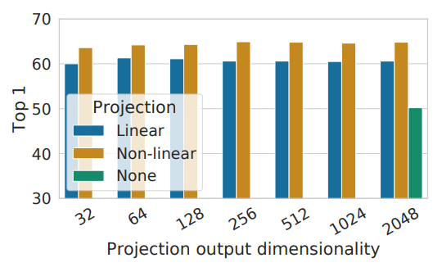
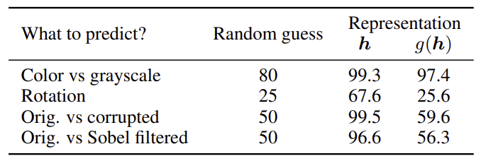
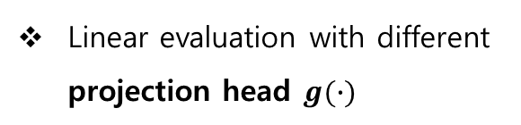
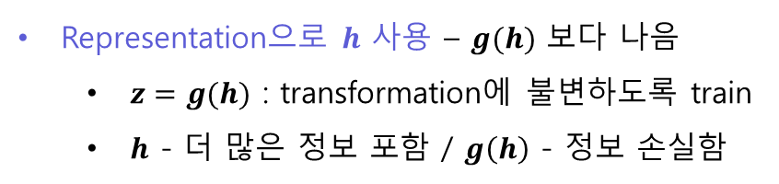
4. Architectures for Encoder and Head
Chen, Ting, et al. "A simple framework for contrastive learning of visual representations." International conference on machine learning. PMLR, 2020.
Projection heads
Linear evaluation of supervised / unsupervised
Linear evaluation with different projection head $g(∙)$
- Projection :
Nonlinear > Linear > None
Accuracy of training additional MLPs
Unsupervised contrastive learning benefits (more) from bigger models
Representation으로 $h$ 사용 – $g(h)$ 보다 나음
$z=g(h)$ : transformation에 불변하도록 train
$h$ - 더 많은 정보 포함 / $g\left(h\right)$ - 정보 손실함

Slide 12
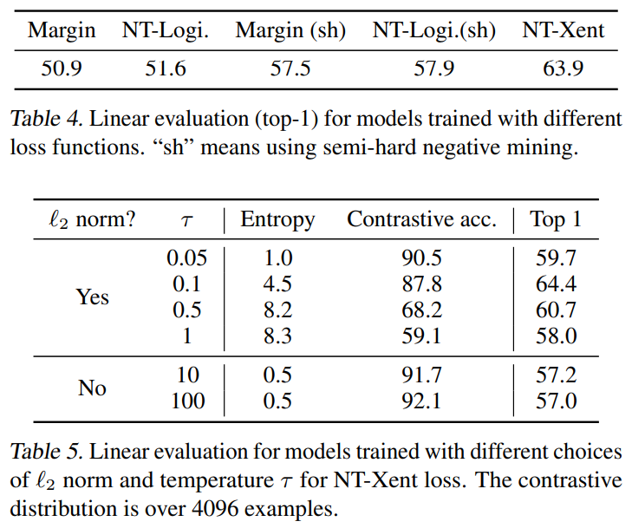
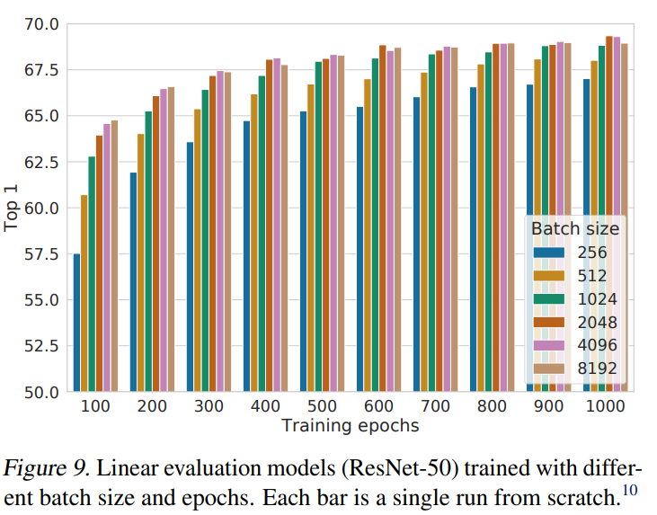
5. Loss Functions and Batch Size
Chen, Ting, et al. "A simple framework for contrastive learning of visual representations." International conference on machine learning. PMLR, 2020.
Loss function
Batch size
Batch Size 클수록 더 좋은 성능
Batch size를 매우 늘릴 경우 충분한 양의 negative sample을 뽑을 수 있기 때문
NT-Xent 성능이 가장 높음

Slide 13
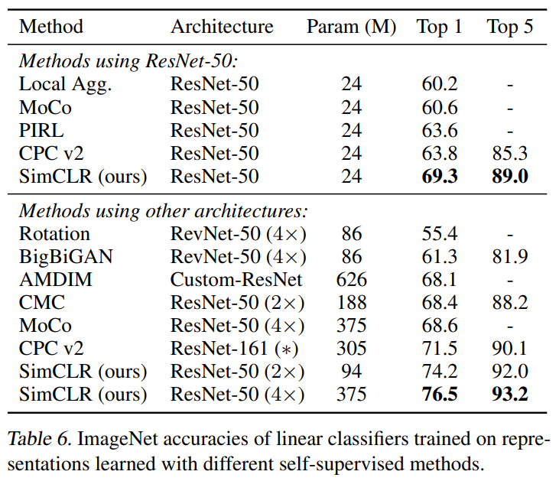
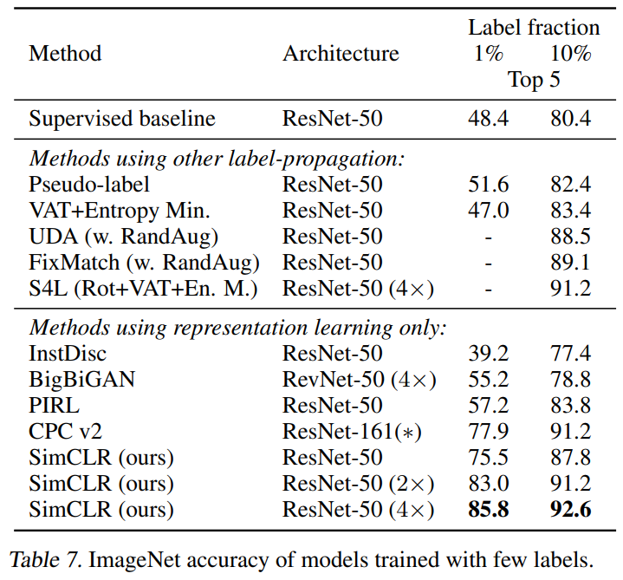
6. Comparison with State-of-the-art
Chen, Ting, et al. "A simple framework for contrastive learning of visual representations." International conference on machine learning. PMLR, 2020.
Linear evaluation
Semi-supervised learning
여러 Self-supervised model과의 비교
SimCLR : 가장 높은 성능
ImageNet의 라벨 데이터에서 1%, 10%씩 클래스 균등 추출, 기존 network에서 fine-tuning하여 성능 향상 확인

Slide 14
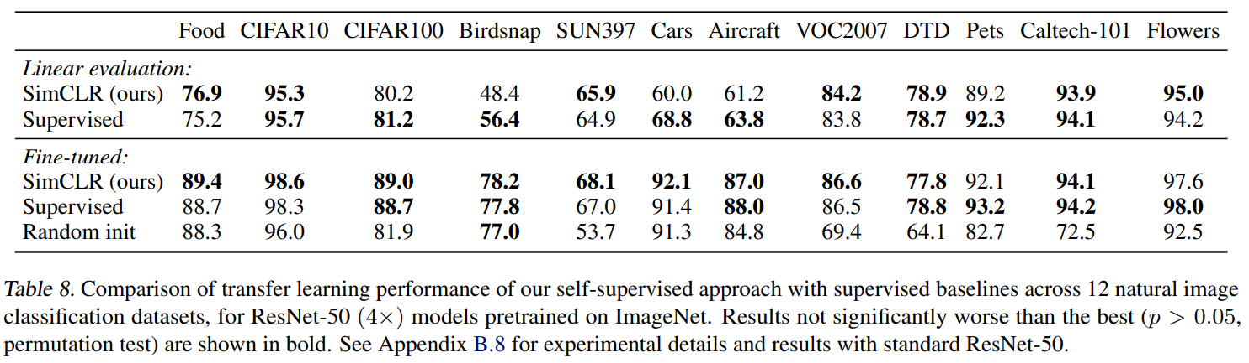
6. Comparison with State-of-the-art
Chen, Ting, et al. "A simple framework for contrastive learning of visual representations." International conference on machine learning. PMLR, 2020.
Transfer learning
다양한 dataset 사용
Linear evaluation : 기존 학습 모델 + 새로운 데이터셋에 linear classifier를 학습
Fine-tuned : 다 학습 → SimCLR : Supervised과 성능이 비슷하거나 더 좋음(5개)

Slide 15
7. Conclusion
Chen, Ting, et al. "A simple framework for contrastive learning of visual representations." International conference on machine learning. PMLR, 2020.
Self-supervised Learning Simple framework로 Self-supervised learning, Semi-supervised learning, Transfer learning의 성능을 크게 개선함
Supervised learning과는 다른 점
Data augmentation, non-linear projection head, the loss function
Representation을 학습하는 것으로 Supervised learning 수준의 성능을 달성함
기존의 Pretext task를 활용하지 않음

